Slide 1
Customer Churn Prediction

Slide 2
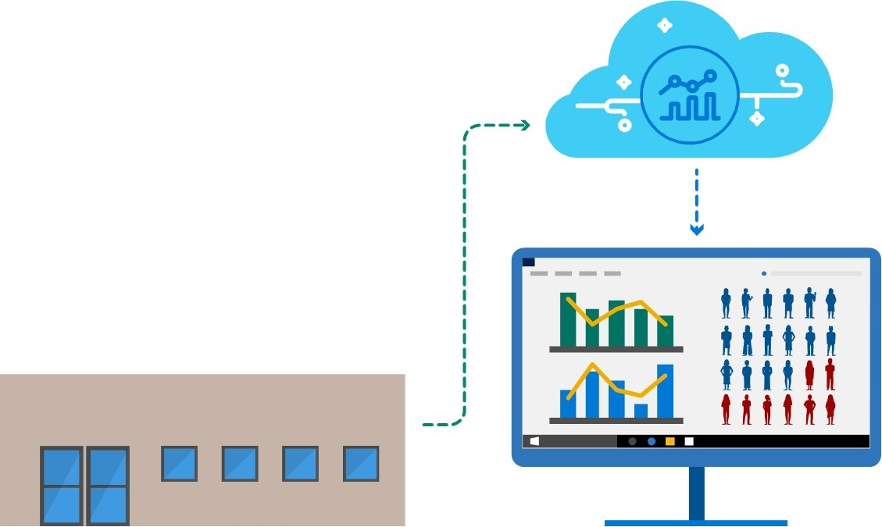
Keeping existing customers is five times cheaper than the cost of attaining new ones.¹ For this reason, marketing executives often find themselves trying to estimate the likelihood of customer churn and finding the necessary actions to minimize the churn rate.
Customer Churn Prediction uses Azure Machine Learning to predict churn probability and helps find patterns in existing data associated with the predicted churn rate. This information empowers businesses with actionable intelligence to improve customer retention and profit margins.
C O N T O S O ‘ S

Slide 3
Why do we need Customer Churn Prediction?

Slide 4
Increasing customer retention by 5%
can increase profits by
25%-95%
Harvard Business School - http://hbswk.hbs.edu/archive/1590.html

Slide 5
The impact of losing a customer is substantial and long reaching. Impacts include:
Lost Sales and Revenue
Opportunities for Competition
Lost Brand Ambassadors
Missing Customer Acquisition Goals

Slide 6
The Value of Existing Customers
CHEAPER TO KEEP
A 2% increase in customer retention is the same as decreasing costs by 10%²
EASIER TO SELL TO
The probability of selling to an existing customer is 60-70%, selling to a new prospect is 5-20%³
INCREASED SALES OVER TIME
Repeat customers spend 67% more in months 31-36 than in their first six months⁴
FREE VALUED ADVERTISING
Repeat customers refer more people to businesses through word-of-month⁵
COMPOUND INVESTMENT
Referred customers can spend 150-175% more than the people that refer them⁶

Slide 7
Benefits
Improve Customer Retention
Proactively launch campaigns and strategies to abate customer attrition
Maximize Profit Margins
Selling to existing customers is more likely and cheaper than selling to new ones
Gain Actionable Intelligence
Know the effects of seasonality on customer churn and the success of campaigns and strategies
Reduce Costs
It is more profitable to keep existing customers than to acquire new ones

Slide 8
Customer Churn Prediction Implementation

Slide 9
Solution Path
DEFINE
Set success criteria for predictions at the start of the solution implementation
PREPARE & PREDICT
Ensure you have the necessary data to make predictions and employ Machine Learning to find the probability of customer churn
RETRAIN
Update the prediction model with the latest customer data to improve prediction accuracy
STRATEGIZE & ACT
Develop plans for customer retention based on prediction results and utilize them
Notes:
New diagram

Slide 10
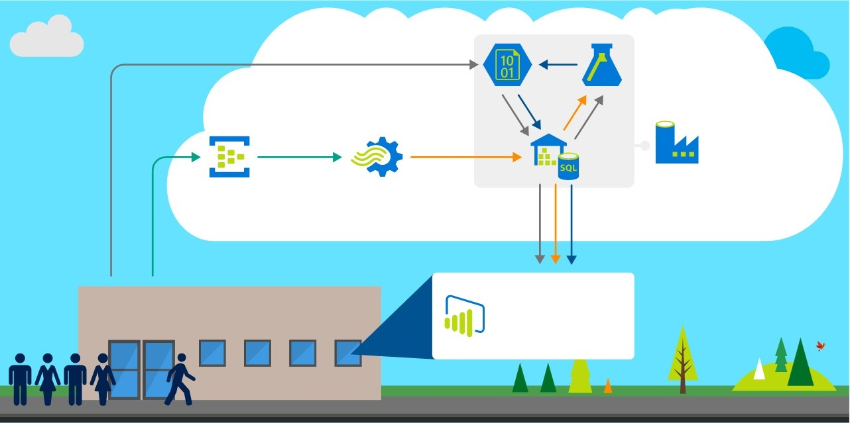
Architecture
Azure Machine Learning
Compares historical and current data to make predictions and give insight into customer churn.
One-time ingestion of historical transaction data
Azure Blob Storage
Historical data is loaded and then transferred to Azure SQL Data Warehouse through PolyBase (for efficiency and speed). Prediction data is transferred from Azure Machine Learning and then loaded into Azure SQL Data Warehouse.
Azure Data Factory
Coordinates data transfer to and from Azure SQL Data Warehouse and Azure Blob Storage and invokes Azure Machine Learning.
Azure Event Hub
Azure Stream Analytics
This highly-scalable service ingests near real-time data.
Time-stamps data and sends it to Azure SQL Data Warehouse.
Azure SQL Data Warehouse
Historical and current data is stored along with predictions.
C O N T O S O ‘ S
Power BI
Delivers predictions, visualizations and reports based on historical and current transaction data

Slide 11
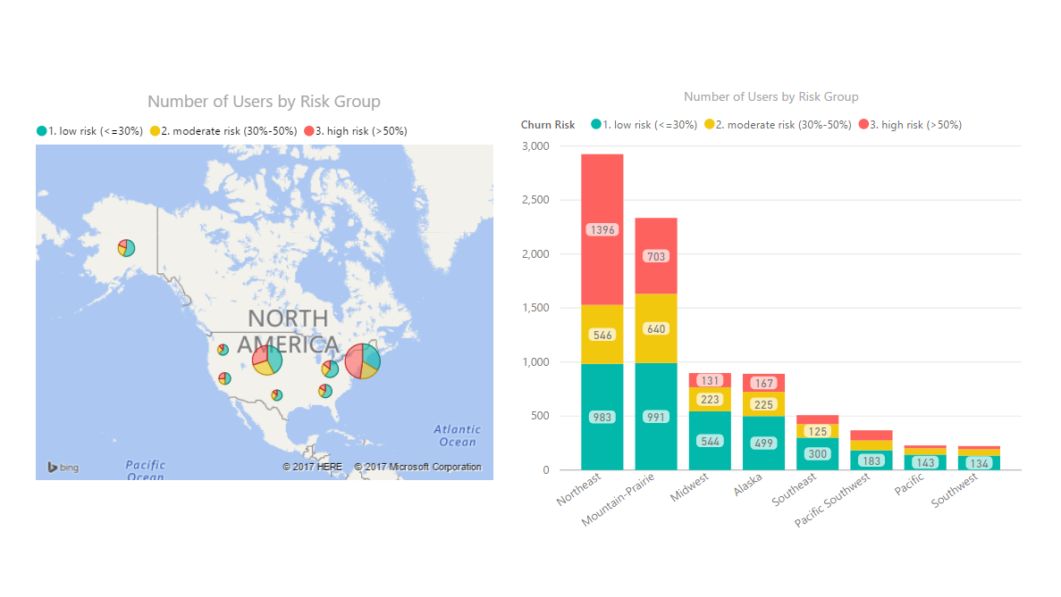
Sample Dashboard

Slide 12
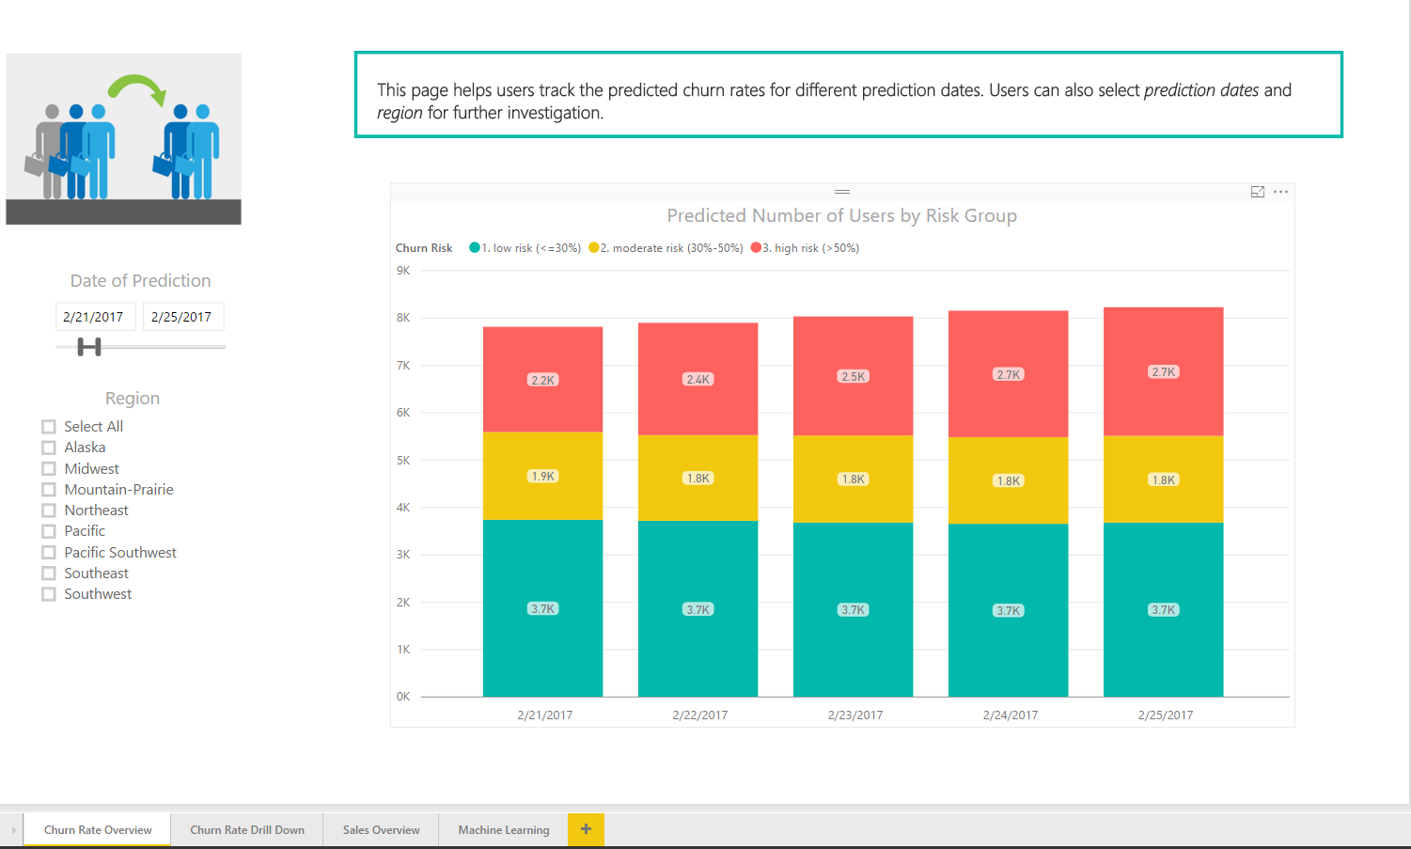
Sample Dashboard

Slide 13
Cortana Intelligence Suite

Slide 14
Cortana Intelligence Suite | Overview
Cortana Intelligence is a fully managed big data and advanced analytics suite in the cloud that transforms data into intelligent action.
Cortana Intelligence…
Allows you to collect, manage, process and store all your data that can seamlessly and cost effectively grow over time in a scalable and secure way.
Provides easy and actionable analytics powered by the cloud that allow you to predict, prescribe and automate decision making for the most demanding problems.
Enables intelligent solutions through cognitive services and agents that allow you to see, hear, interpret and understand the world around you in more contextual and natural ways.

Slide 15
Cortana Intelligence Suite | Advantages
COST
SCALABILITY
GROWTH
There are no upfront costs or COGS (Cost of Goods Sold) component costs associated. Meaning there is no need to invest in hardware, software, and/or IT maintenance. This translates into a substantial reduction in business risk.
Servers for computing and/or storage can be deployed and scaled on an as-needed basis and can be done quickly and easily. This effects the cost efficiency advantage of a cloud-based solution with a pay-for-what-is-used policy.
Features, components, and capabilities are consistently being introduced and evolved in Cortana Intelligence Suite. As such, they can easily and quickly be implemented in a cloud-based solution.

Slide 16
Cortana Intelligence Suite | Overview
Information Management
Big Data Stores
Machine Learning and Analytics
Intelligence
Data Sources
People
Data Factory
Data Lake Store
Machine Learning
Cognitive Services
Data Catalog
SQL Data
Warehouse
Data Lake Analytics
Bot Framework
Web
Apps
Event Hubs
HDInsight
Cortana
Mobile
Apps
Stream Analytics
Bots
Dashboards & Visualizations
Sensors and Devices
Power BI
Automated Systems
Data
Intelligence
Action

Slide 17
Appendix

Slide 18
References
¹Harvard Business Review - https://hbr.org/2014/10/the-value-of-keeping-the-right-customers
²"Leading on the Edge of Chaos" by Emmett C Murphy
³”Marketing Metrics” by Paul Farris, Neil Bendle, Phillip Pfeifer, and David Reibstein
^{4, 5, 6}Bain & Company - http://www.bain.com/publications/articles/the-value-of-online-customer-loyalty-and-how-you-can-capture-it.aspx

Slide 19
Cortana Intelligence Suite | Used in this Solution
Azure Machine Learning
Azure Machine Learning is a cloud predictive analytics service that makes it possible to quickly create and deploy predictive models as analytics solutions. It learns from data in order to forecast future behaviors, outcomes, and trends. These forecasts or predictions from machine learning can make apps and devices smarter. You can work from a ready-to-use library of algorithms, use them to create models on an internet-connected PC, and deploy your predictive solution quickly. Start from ready-to-use examples and solutions in the Cortana Intelligence Gallery.
Azure Machine Learning not only provides tools to model predictive analytics, but also provides a fully managed service you can use to deploy your predictive models as ready-to-consume web services.

Slide 20
Cortana Intelligence Suite | Used in this Solution
Azure Event Hubs
Azure Event Hubs is a hyper-scale telemetry ingestion service that collects, transforms, and stores millions of events. As a distributed streaming platform, it offers low latency and configurable time retention that enable ingression of massive amounts of telemetry into the cloud and read the data from multiple applications using publish-subscribe semantics. Event Hubs ingests events with elastic scale to accommodate variable load profiles and the spikes.
As a fully managed service, there are no servers to maintain and no software licenses to acquire. Pricing is simple and easy to predict. Event Hubs lets you focus on getting value from your telemetry rather than on gathering the data.

Slide 21
Cortana Intelligence Suite | Used in this Solution
Azure Stream Analytics
Azure Stream Analytics produces insights from devices, sensors, infrastructure, and applications. It processes ingested events in real-time, comparing multiple streams or comparing streams with historical values and models. Stream is also able to detect anomalies, transform incoming data, trigger an alert when a specific error or condition appears in the stream, and is able to display this real-time data in your dashboard.
Stream Analytics scales to any volume of data while still achieving high throughput, low-latency, and guaranteed resiliency. Get all of this without incurring hardware or other up-front costs and without time-consuming installation or setup.

Slide 22
Cortana Intelligence Suite | Used in this Solution
Azure SQL Data Warehouse
Unlike other cloud services SQL Data Warehouse (DW) truly delivers on the promise of cloud elasticity, making it ideal for batch-based data warehouse workloads. Utilizing a decoupled storage and compute model, DW allows you to easily scale compute in seconds without over-provisioning or over-paying.
Built-into SQL Data Warehouse, Microsoft PolyBase technology simplifies and enables distributed analytics and allows you to run a single query using familiar tools over multiple data sources. Seamless compatibility with SQL Server Integration Services, Azure Analysis Services, Azure Stream Analytics, Azure Machine Learning, Azure Data Factory, and Azure Storage ensures insight across all of your data, as fast as it’s coming in.

Slide 23
Cortana Intelligence Suite | Benefits
Cortana Intelligence Suite enables you to realize your business outcomes by providing tools to transform data into intelligent action. It transforms entire systems of production, management and governance by enabling you to reap business benefits such as:
Improve visibility and prediction accuracy
Get the right products to the right places efficiently
Offer customers exactly what they want, when they want it
Fix problems proactively before they start
Capture new business opportunities
Use Cortana Intelligence Suite to improve outcomes and solve challenges across all aspects of your business.

